Slide 1

Finding an Edge in Sports Betting
Team E – Joseph Schoenbaum and Gabriel Kuykendall

Slide 2
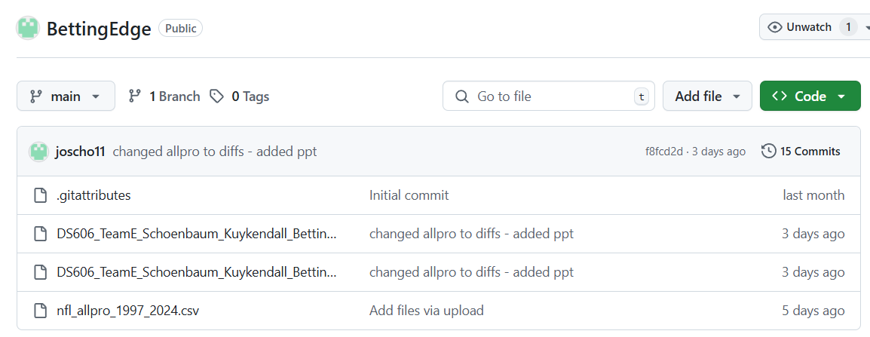
GITHUB FOR OUR PROJECT
https://github.com/joscho11/BettingEdge

Slide 3
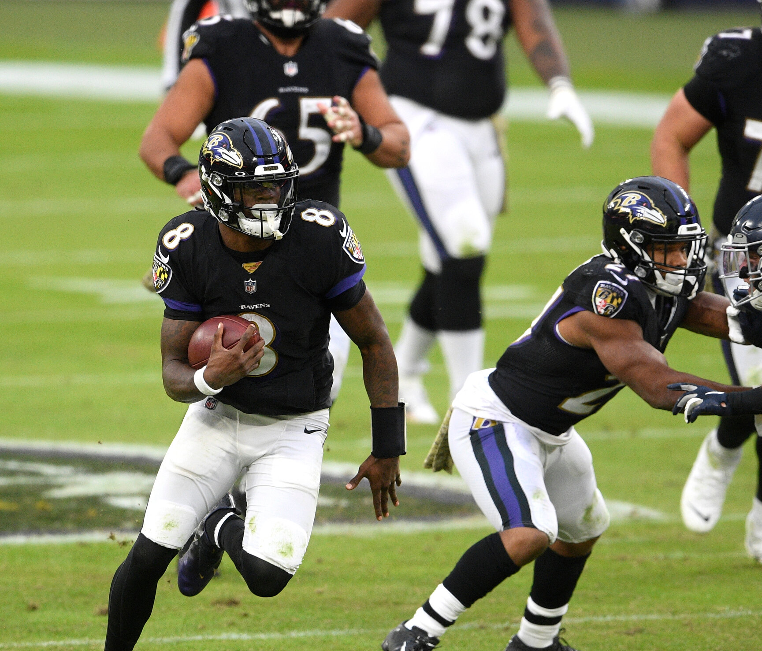
Overview
Refresher on Project
EDA
Modeling
Next Steps
References
Q&A

Slide 4
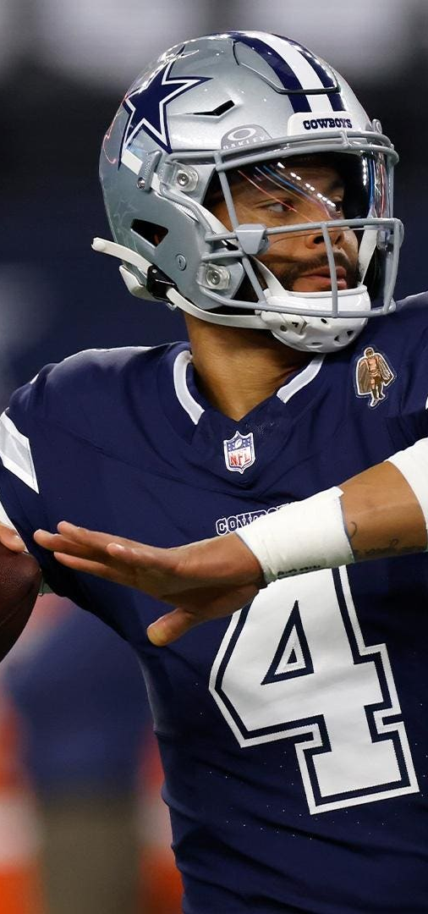
Project Refresher
Using different match related features, create several models to predict the score difference in NFL games
Compare our new spreads to existing spreads
Determine the effectiveness our spreads in improving the earnings of bettors

Slide 5
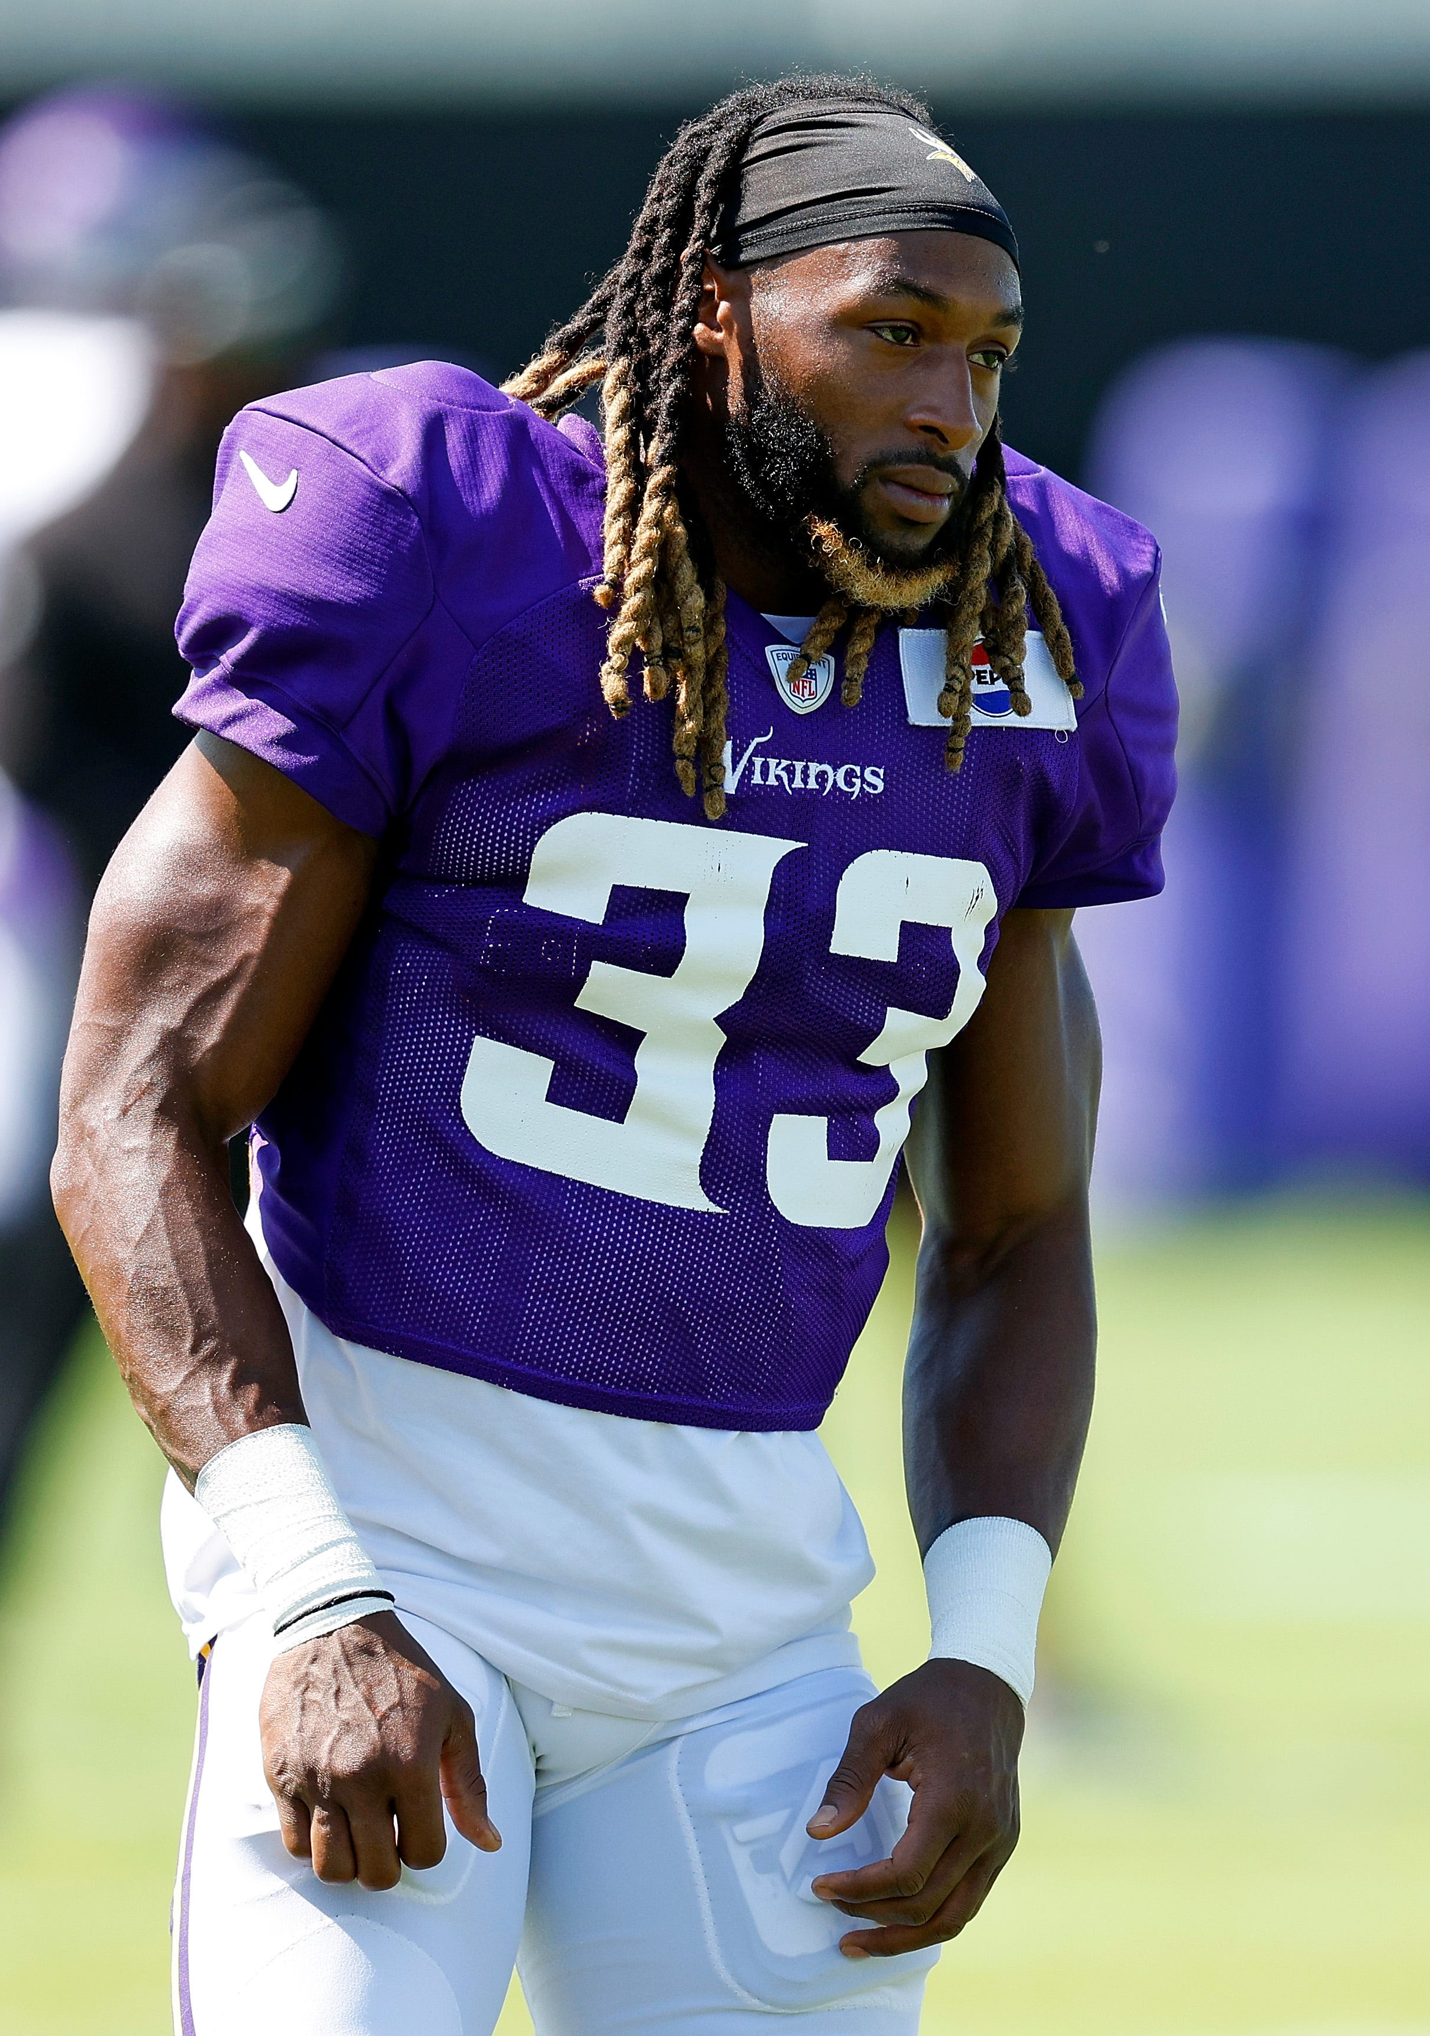
Similar Projects
https://www.kaggle.com/code/dubradave/nfl-injuries-grass-vs-fieldturf
Used nfl_data_py to evaluate injuries based on field type
https://www.kaggle.com/code/twalters20/nfl-betting-model#Feature-and-Model-Testing
Created a betting model to determine if the favored team would cover the spread

Slide 6
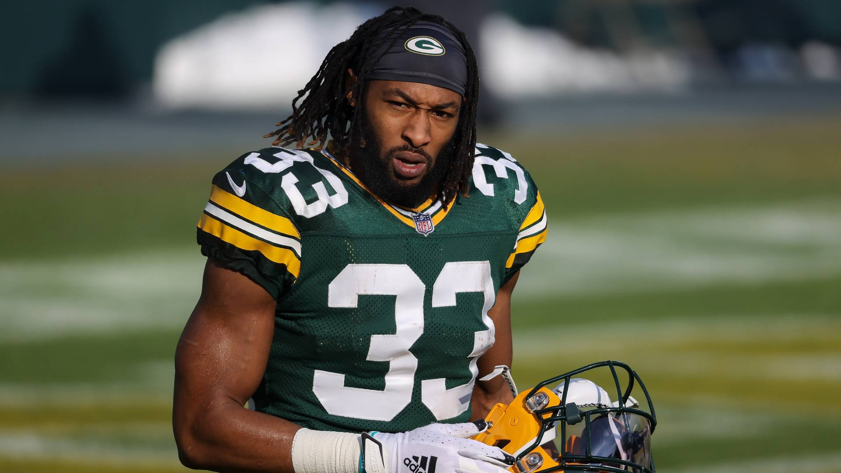
Similar Projects Cont.
https://python.plainenglish.io/using-python-to-mimic-nfl-sportsbook-odds-determination-2d96dc84ecab
Used multiple NFL datasets including nfl_data_py in order to replicate Vegas Odds for NFL games
Used a linear regression model
Results were evaluated against the actual Vegas Spread and saw positive correlation between the model and actual Spreads

Slide 7
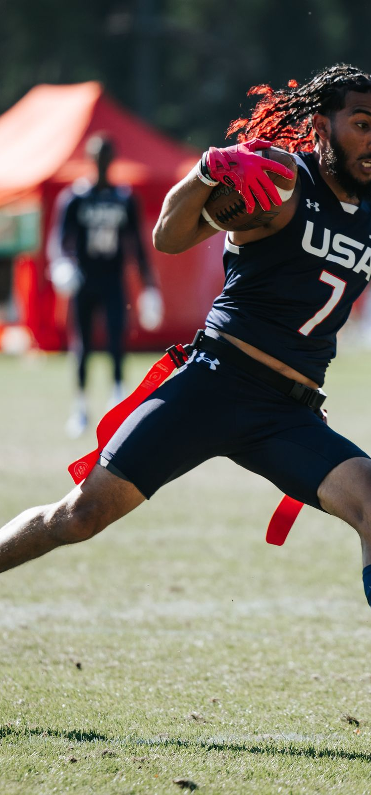
Dataset information
For our project we will be using data from a python library called nfl_data_py
nfl_data_py is a Python library for interacting with NFL data sourced from nflfastR, nfldata, dynastyprocess, and Draft Scout
Includes import functions for play-by-play data, weekly data, seasonal data, rosters, win totals, scoring lines, officials, draft picks, draft pick values, schedules, team descriptive info, combine results and id mappings across various sites
Our project will use game data from 2000 to 2025
Ex: each row will include information about an event – 02/09/25 - Kansas City Chiefs vs Philadelphia Eagles (22 – 40)
Original dataset
6732 rows and 46 columns
Link to library - https://pypi.org/project/nfl-data-py/
Link to github of library - https://github.com/nflverse/nfl_data_py/tree/main
Used All-Pro data from profootballreference to create a table used for several features
1975 rows and 5 columns

Slide 8
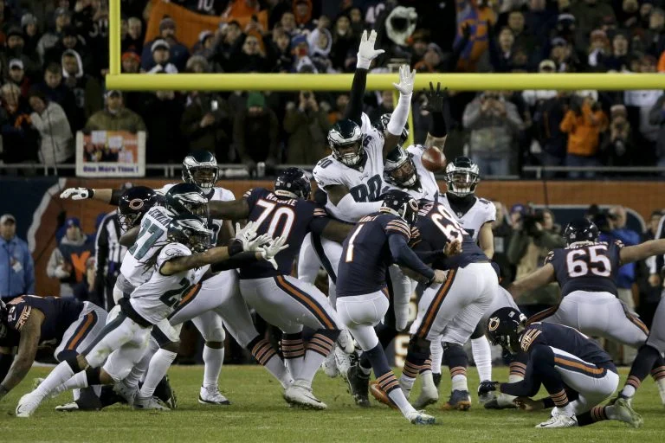
Created Features
Season Context
is_playoffs
is_final_week
Quarterback Changes
home_qb_switch, away_qb_switch
Expected Points Added
home_rolling_avg_epa, away_rolling_avg_epa, home_rolling_allowed_avg_epa, away_rolling_allowed_avg_epa
Offense and Defense Metrics
home_rolling_avg_yards, away_rolling_avg_yards,home_rolling_allowed_avg_yards, away_rolling_allowed_avg_yards
home_rolling_play_count, away_rolling_play_count, home_rolling_allowed_play_count, away_rolling_allowed_play_count
Strength of Schedule
home_recent_sos_opponent_avg, home_season_sos_opponent_avg, away_recent_sos_opponent_avg, away_season_sos_opponent_avg, sos_diff, season_sos_diff
All-Pro Features
diff_allpro_last_3_years_weighted, home_offense_allpro_3_years, diff_home_off_away_def_3_years,diff_home_def_away_off_3_years
diff_allpro_prev_year, diff_home_off_away_def_prev_year, diff_home_def_away_off_prev_year

Slide 9
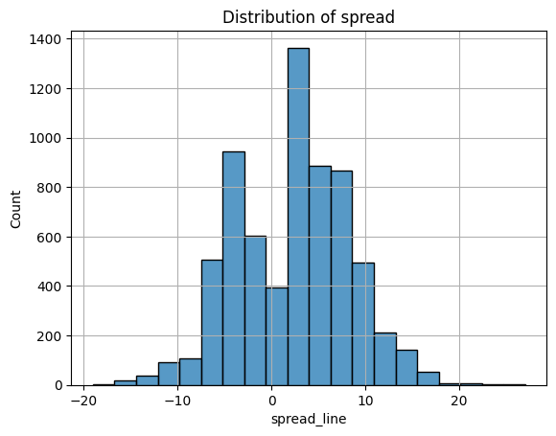
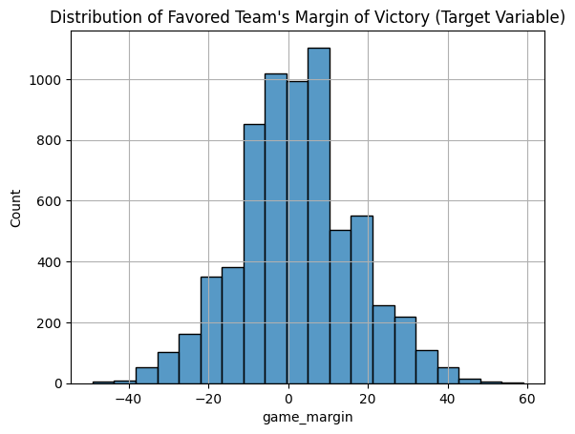
EDA
Dataframe info
Feature counts
Heatmap
Distribution of target variable (game margin)
Distribution of spread line

Slide 10
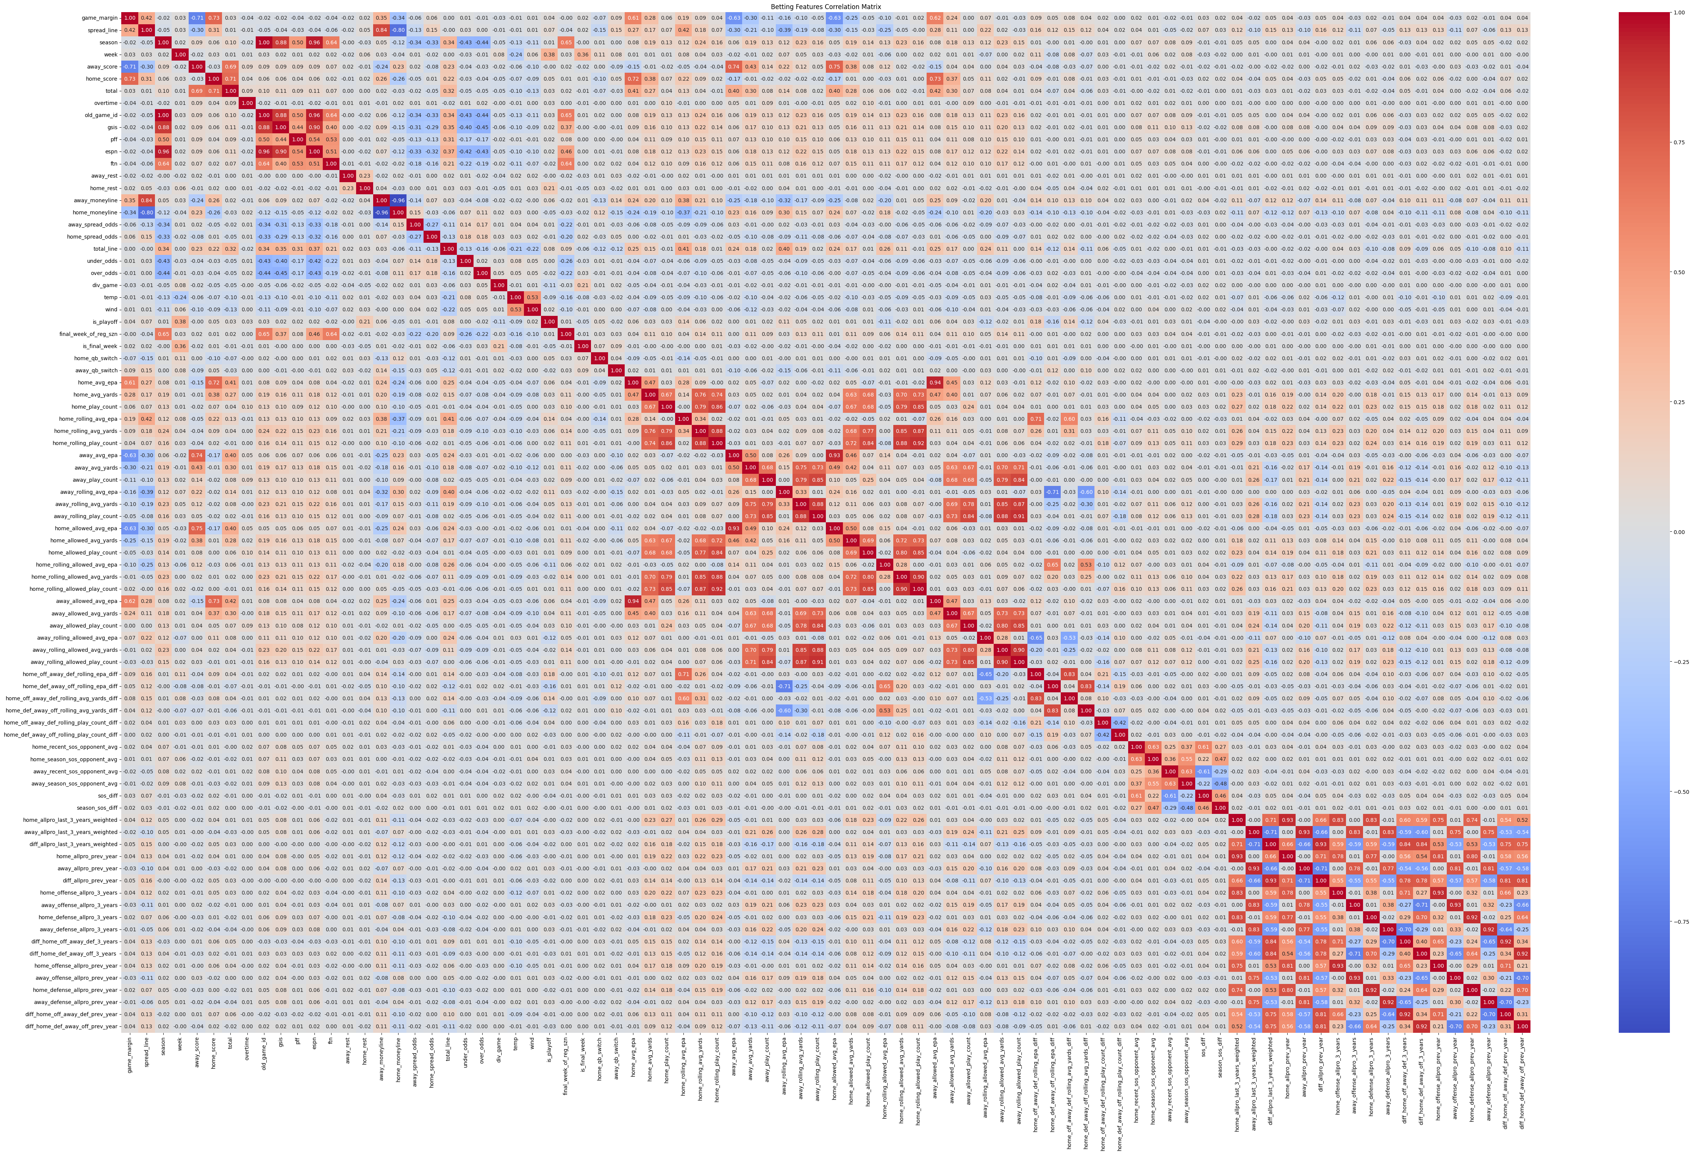
Heat Map

Slide 11
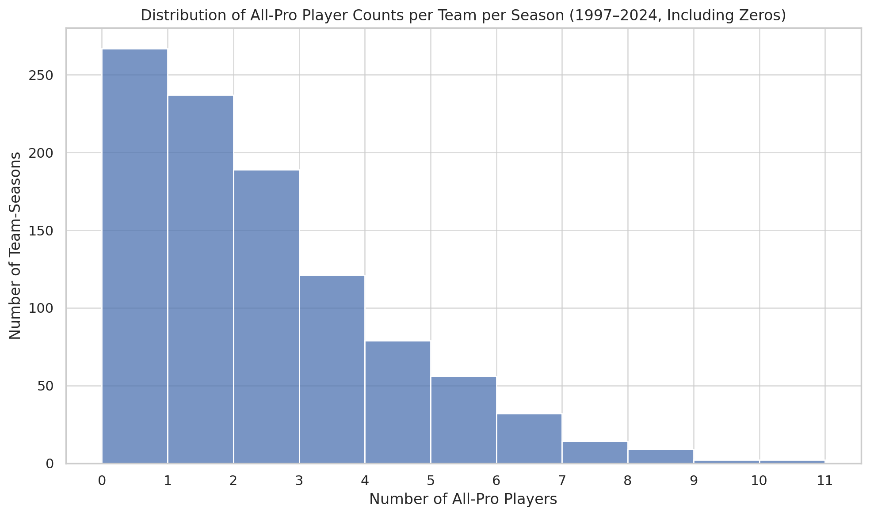
All-Pro EDA

Slide 12
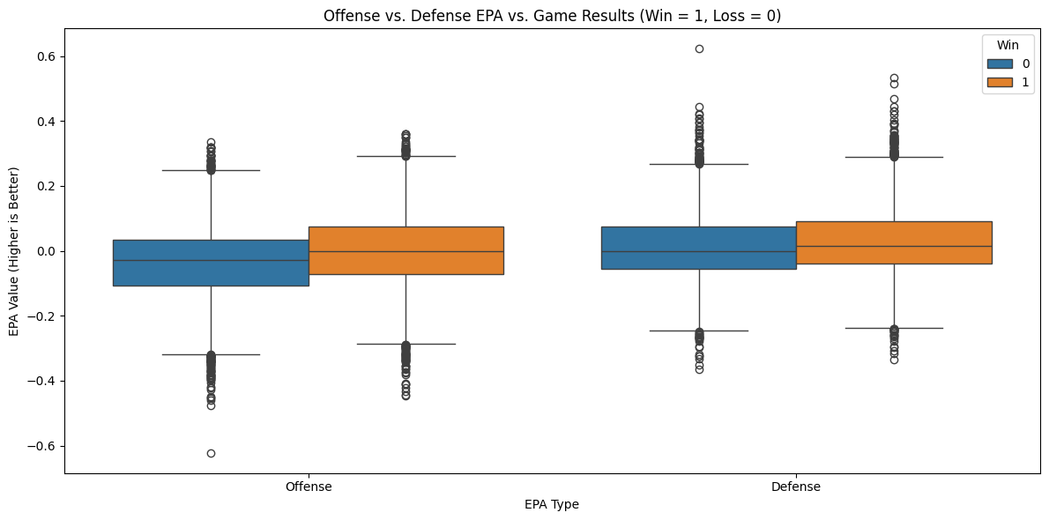
EPA EDA

Slide 13
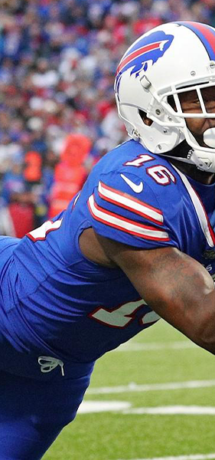
Initial Modeling – Random Forest Regressor
Based on our training we currently have 61 features
Due to encoding on categorical variables for the random forest regressor there are over a 1000 features initially
The goal of our first model is to focus in on what features are most important to our model
This can give us a better understanding of what features to focus on for further modeling/additional features in the future
Performance is relative – football is noisy
The initial evaluation metrics used are r-squared value and mean absolute error (MAE)
MAE – allows us to see how far off our prediction is without penalizing errors that are far off
Football is very noisy; outliers are bound to happen so penalizing them does not make sense
R-squared – allows us to see how well the model is capturing the variability in the data
A simple evaluation metric to see another viewpoint of our model
Current model splits the data 80/20
Current not using validation or cross-validation as this was an initial model to understand important features, in contrast to strengthening model performance

Slide 14
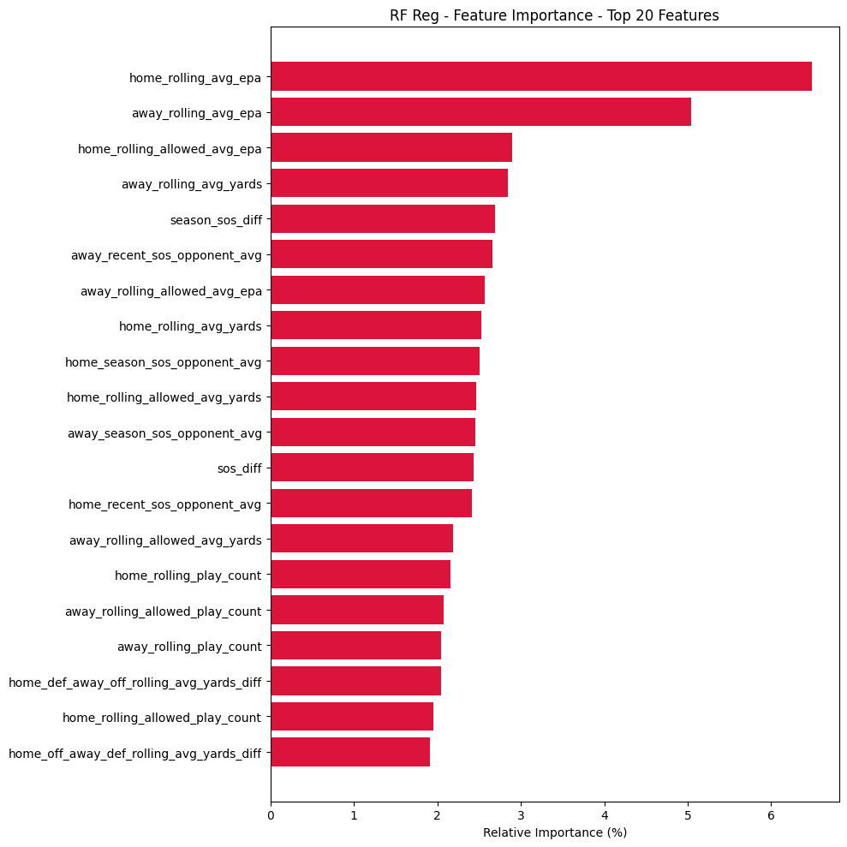
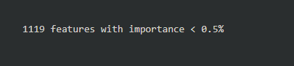
Feature Importance

Slide 15
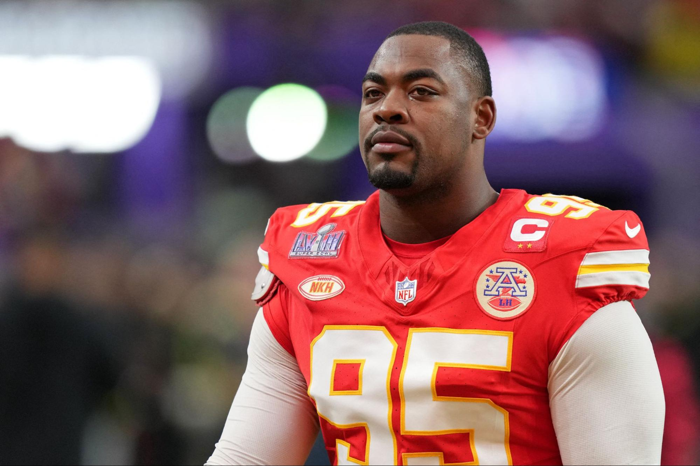
Initial Model Analysis
The MAE for our model is 10.58 which means, on average, our model predicted a game margin off by approximately 10.58 points from the real value
Typically, NFL game margins are single digit
The model is performing worse than just predicting the mean margin
NFL games are noisy
Game margins can vary heavily by just one play
An R-squared score of 9.75% means our model explains 9.75% of the variance in game margin
This is low, but not unexpected as the NFL and sports in general are very noisy
Feature Importance shows recent team performance is very important when predicting game margin
External variables such as roof, surface, stadium, etc. do not seem to have much impact
Next Iteration - Reduce redundant features

Slide 16
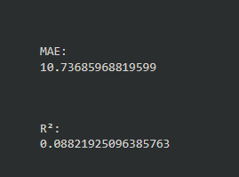
2nd Iteration – Random Forest Regressor
The goal of this iteration is to remove redundant features to get a clearer picture of the most impactful features
Removal of features will slightly reduce performance

Slide 17
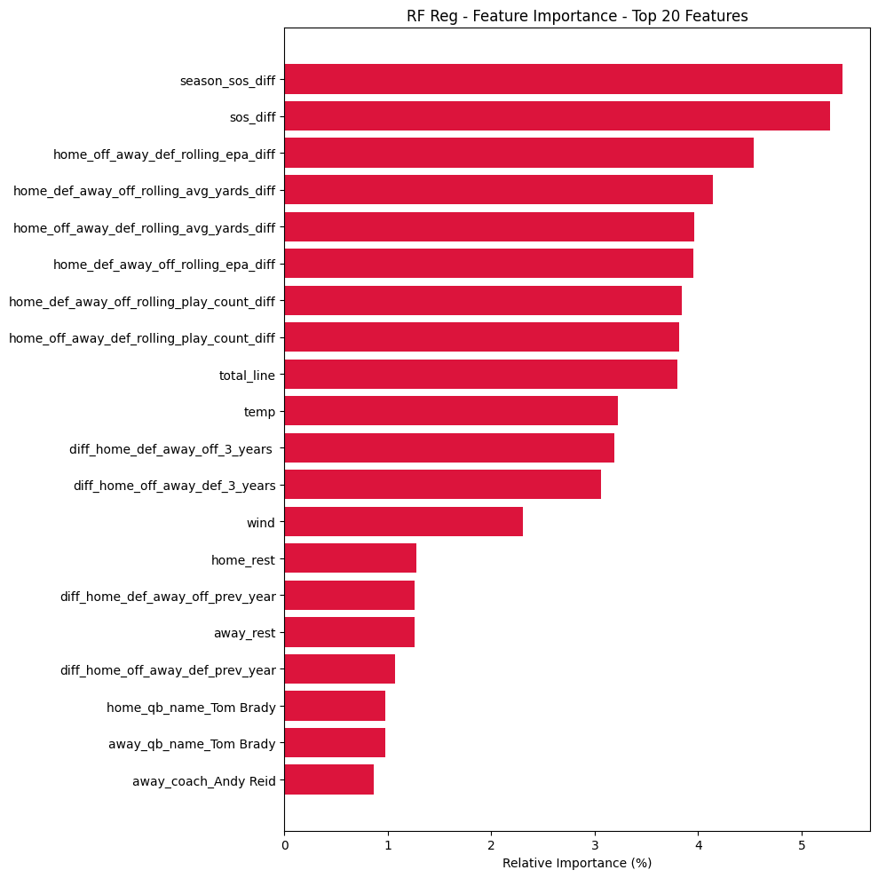

Slide 18
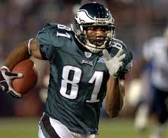
Initial Modeling – XGBoost Model
Based on our training we currently have 61 features
Our XGBoost model does not expand the number of features during preprocessing like Random Forest with One-Hot Encoding — instead, it uses ordinal encoding for categorical variables, resulting in a more compact feature set.
The goal of our first model is to focus in on what features are most important to our model
This can give us a better understanding of what features to focus on for further modeling/additional features in the future
Performance is relative – football is noisy
The initial evaluation metrics used are r-squared value and mean absolute error (MAE)
MAE – allows us to see how far off our prediction is without penalizing errors that are far off
Football is very noisy; outliers are bound to happen so penalizing them does not make sense
R-squared – allows us to see how well the model is capturing the variability in the data
A simple evaluation metric to see another viewpoint of our model
Current model splits the data 80/20
Future iterations will look to include feature pruning and cross-validation

Slide 19
Initial XGBoost Model Analysis
The MAE for our model is 11.02 which means, on average, our model predicted a game margin off by approximately 11.02 points from the real value
Typically, NFL game margins are single digit
The model is performing worse than just predicting the mean margin
NFL games are noisy
Game margins can vary heavily by just one play
An R-squared score of 0.10 means our model explains 10% of the variance in game margin
This is low, but not unexpected as the NFL and sports in general are very noisy
Very similar results to the Random Forest initial model
Feature importance shows that boolean data features were most important

Slide 20
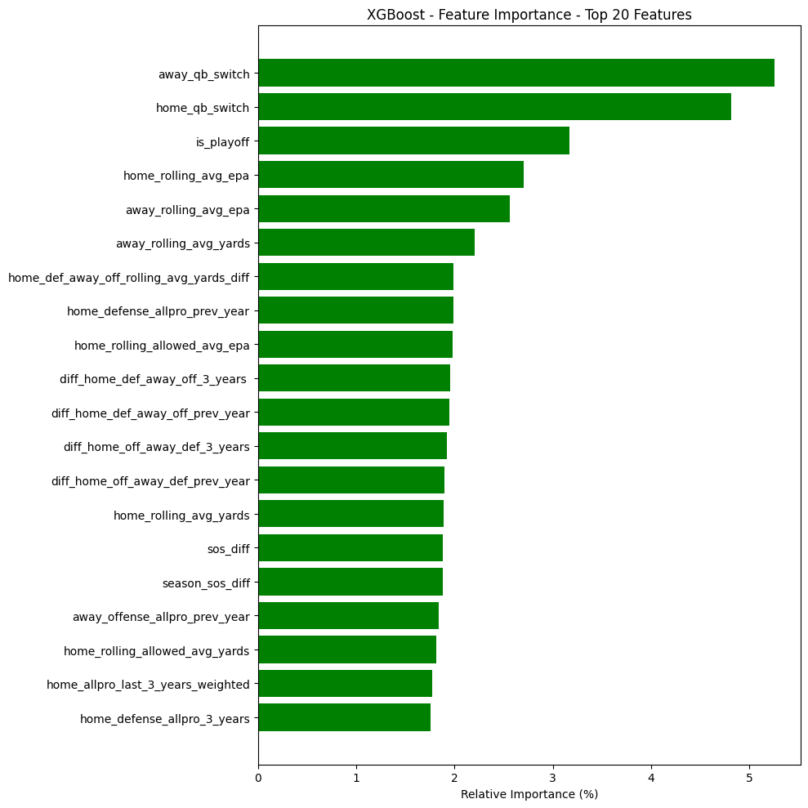
XGBoost Model

Slide 21
Next Steps
Look further into our random forest regressor to improve through modeling techniques and modifying hyperparameters
Add other features related to the most important features found from our initial model run throughs
Help to improve performance on other models

Slide 22
References
NFL_Data_py dataset - https://pypi.org/project/nfl-data-py/
All-pro dataset - https://www.pro-football-reference.com/years/2024/allpro.htm

Slide 23
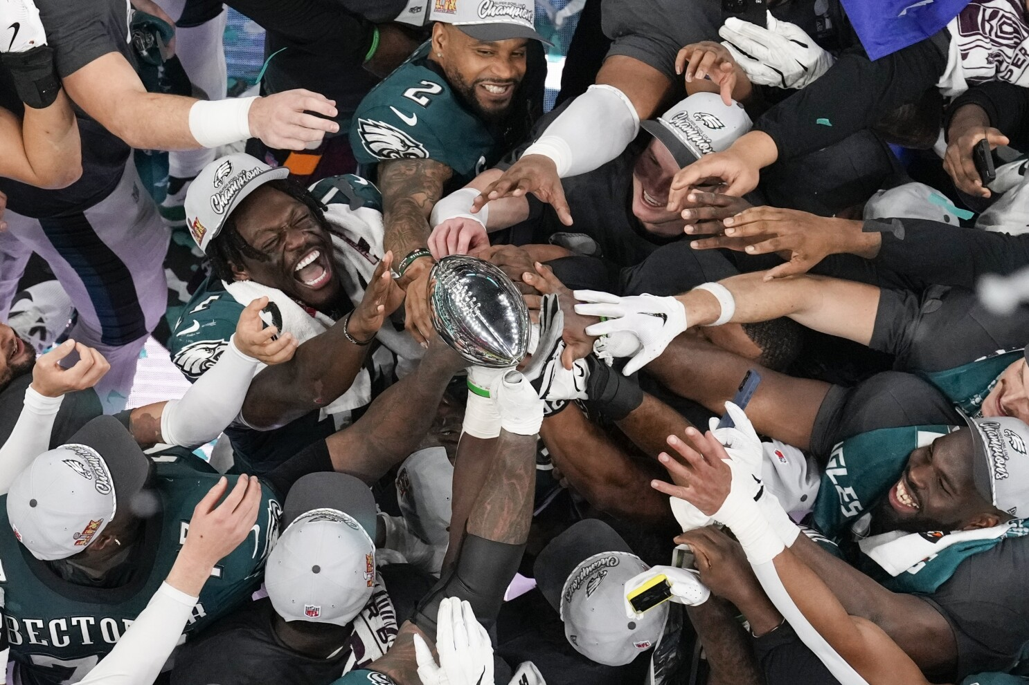
Q&A

